Slide 1
KENDO UI
AMAL DEV
UST GLOBAL

Slide 2
AGENDA
Introduction
Overview
Flavors
Installation
Support
Web Widgets

Slide 3
Overview
HTML5/CSS3/jQuery based framework
Lot of Web Widgets
Rich Data Visualization Framework
Auto-Adaptive Mobile Framework
Cross Browser Support
Cross Platform Support
Support for PHP, JSP, ASP.NET
Notes:
Basically a collection of styles, scripts and images
Leverages existing technologies to make rich immersive web applications
Web – widgets for both web and touch enabled desktop development
DataViz – used for development of desktop websites as well as mobile websites, normally used for representing data which include charts as well as guages
Mobile – features adaptive rendering technology which displays natively feel for ios, android, wp, includes controls such as scroll view, tab strip, list view, navigation buttons
Features – performance

Slide 4
Flavours
Kendo UI Core
Kendo UI Professional
Telerik UI for ASP.NET MVC
Telerik UI for JSP
Telerik UI for PHP
Notes:
Free, open source, includes web, mobiles widgets and framework features
Includes web data viz, mobile widgets and framework features
ASP.NET MVC wrapper for all available widgets
JSP wrappers available for web and data viz widgets
PHP available for web and data viz widgets
Server side wrappers are classes or xml tags which generates kendo ui widgets from server side code

Slide 5
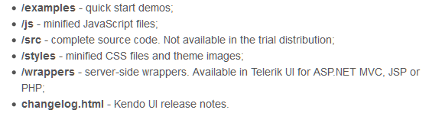
Installation
Requires jQuery v1.9.1
Download package from
http://www.telerik.com/download/kendo-ui
Package Structure

Slide 6
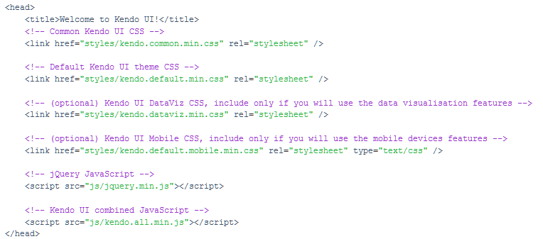
Usage
Copy JS and Styles directories to your root folder
Include the files in your page
Notes:
Common.css file is registered before the theme.css file

Slide 7


Initializing Widget
jQuery Syntax
HTML 5 Syntax
Notes:
Add an html element, select the element thru jquery and apply js method from kendo namespaces to convert it into a widget
Declarative Initialization- typically adds special attributes to your element starting with data-, then calls an initializer that reads these attributes and apply these changes

Slide 8
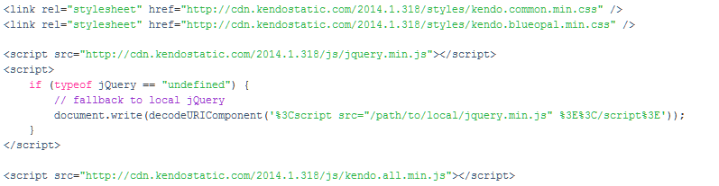
Kendo UI CDN
Hosted on Amazon Cloud Front
All are minified files
Local fallback option is recommended
Notes:
Should plan for a fallback option while using files hosted in cdn
Connectivity issues, firewalls, antivirus

Slide 9
Best Practices
Include only what you need.
Seperate js files are available for each widgets.
Avoid registering duplicate scripts.
Pick right combined script based on your project.
kendo.web.min.js -> core framework, desktop browser widgets
kendo.dataviz.min.js -> core framework, data viz widgets
kendo.mobile.min.js - > core framework, mobile specific widgets
Use Download builder for custom combined script
Notes:
3. kendo.grid.js should not be registered together with kendo.web.js or kendo.all.js
5. Only for licensed user, core users can opt for grunt

Slide 10
Demo
Getting Started
Using jQuery plugin
Using Markup

Slide 11
Demo
Initialize multiple Items at Once
Chaining
Obtaining Reference
Event Binding
Notes:
Multiple items
Chaining
Avoid duplicate initialization
Obtain a reference using jquery

Slide 12
Data Visualization

Slide 13
Charts
Bar and Column
Line and Vertical Line
Area and Vertical Area
Bullet
Pie and Donut
Scatter
Scatter Line
Bubble
Radar and Polar
Notes:
Supports the above series types
The Chart widget uses modern browser technologies to render high-quality data visualizations. All graphics are rendered on the client using SVG with a fallback to Canvas and VML.
can visualize series bound to both local and remote data.
XY charts such as Scatter and Scatter Line use one or more X and Y axes

